Slide 1

COVID-19 Time series analysis

Slide 2

Agenda
Introduction
Data collection
Background
Methodology
Visualizing results with Tableau
Conclusion

Slide 3

Our objective is to develop a time series analysis for covid-19 historical data. Our goal is to extract insights crucial for navigating this global crisis. Through seasonal decomposition and Prophet modelling, we're uncovering COVID-19's trends and drivers. These insights aren't just about understanding the past but guiding our future responses.
Introduction

Slide 4

Data collection
I had historical weekly data from USA during period from May 2020 till March 2024 which were collected from nursing homes and submitted through the Centers of Disease Control and Prevention (CDC) National Healthcare Safety Network (NHSN) system.
Data contained 3 millions wors and 21 columns. For further analysis I used random sample.
My goal was to predict weekly COVID-19 cases and COVID-19 death

Slide 5

Background
Seasonal Decomposition: This technique breaks down time series data into trend, seasonality, and residual components, revealing hidden patterns crucial for forecasting.
Prophet Modelling: Developed by Facebook, Prophet excels at handling data with seasonal patterns and irregularities, making it perfect for analysing COVID-19 trends. Its intuitive interface and automatic feature selection streamline the modelling process, enabling rapid iteration and experimentation.

Slide 6
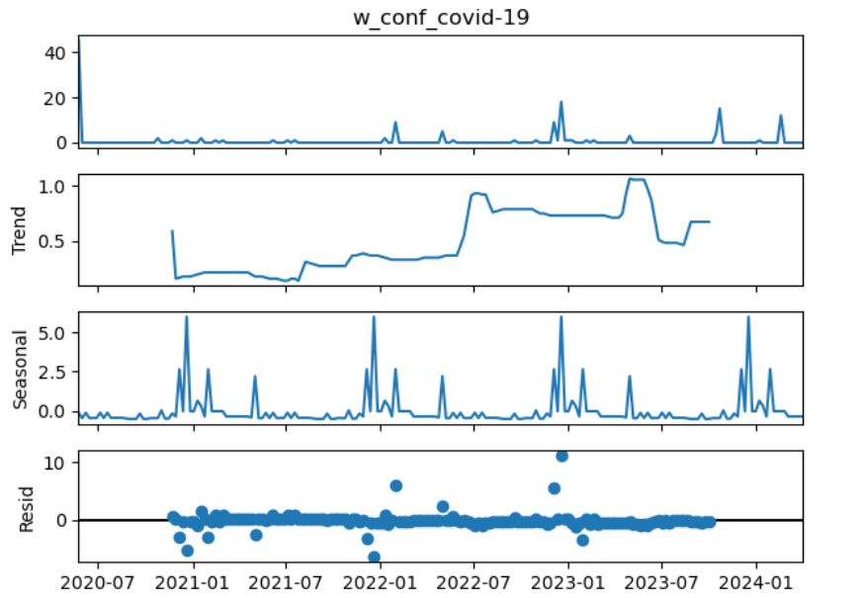
Methodology. Seasonal decomposition
Trend Component: Shows an upward trajectory in weekly confirmed cases with significant fluctuations, with an average growth rate of 0.37%. Notable increase in cases is observed in 2022, indicating a significant rise during that period.
Seasonal Component: Demonstrates pronounced seasonality, with peaks during winter months correlating with increased transmission rates due to colder temperatures and indoor gatherings. The average peak magnitude is 0.92 cases per week, varying across years.
Residuals: The model effectively captures underlying patterns, with residuals appearing random and centered around zero. However, further validation through statistical tests and forecast accuracy assessments is needed for confidence in predictive capabilities.

Slide 7
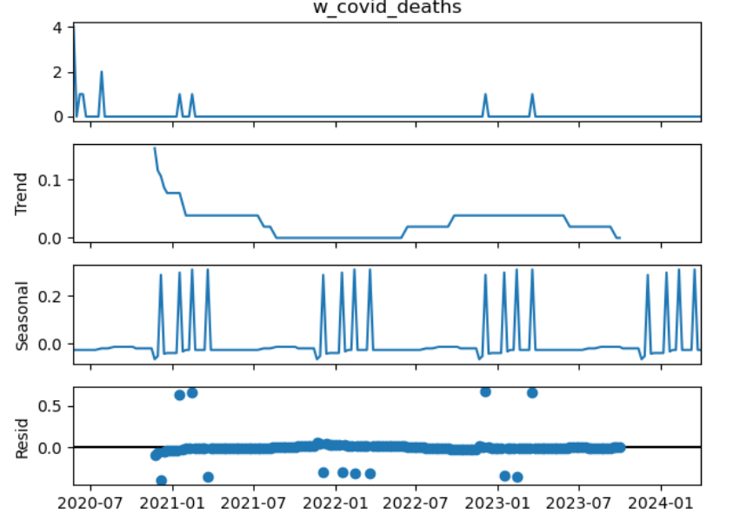
Methodology. Seasonal decomposition
Trend Component: Shows a consistent downward trajectory in weekly confirmed COVID deaths, with a weekly growth rate of -1, which indicates that, on average, the number of weekly confirmed COVID deaths is decreasing by 1 unit per week. . A slight increase in 2022-2023 corresponds to rising COVID incidences.
Seasonal Component: Demonstrates pronounced seasonality, with peaks during winter months. These coincide with colder temperatures and increased indoor gatherings, likely leading to higher transmission rates. The average peak magnitude is 0.29 cases per week, varying across years.
Residuals: The model effectively captures underlying patterns, with residuals appearing random and centered around zero.

Slide 8
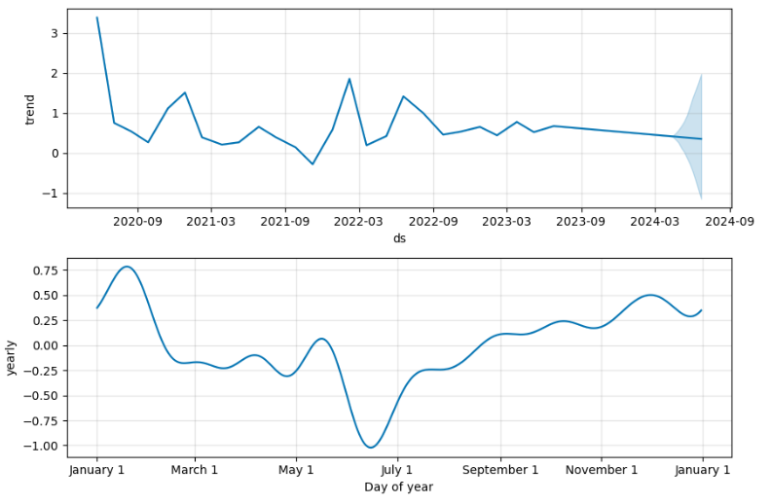
Methodology. Prophet
Overall Trend: Fluctuating pattern initially, followed by stabilization.
Peaks and Troughs: Periodic fluctuations influenced by various factors.
Recent Trends: Stabilization or decline in cases due to mitigation measures and vaccination.
Yearly: Data reveals fluctuations, with a downward trend in a first 6 month of the year, followed by an upward trend until December.

Slide 9
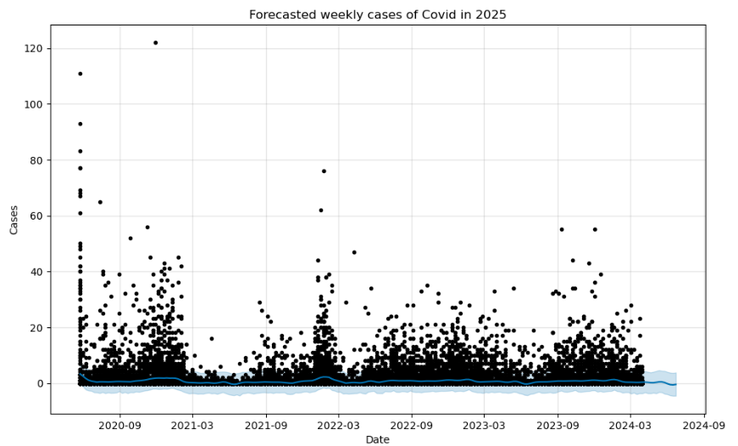
Methodology. Prophet
Decreasing Trend: Steady decline in forecasted cases.
Gradual Reduction: Consistent decrease over time.
Stability: Fluctuations but overall downward trend.
Long-Term Projection: Continued decline in forecasted cases.
Cautious Optimism: Effectiveness of measures in controlling the virus.
For model evaluation I used cross_validation and performance_metrics from prophet.diagnostics:
Mean Absolute Error: 0.83
Mean Squared Error: 5.98
Root Mean Squared Error: 2.45
To achieve this results, I experimented with different hyperparameters, using grid search.

Slide 10
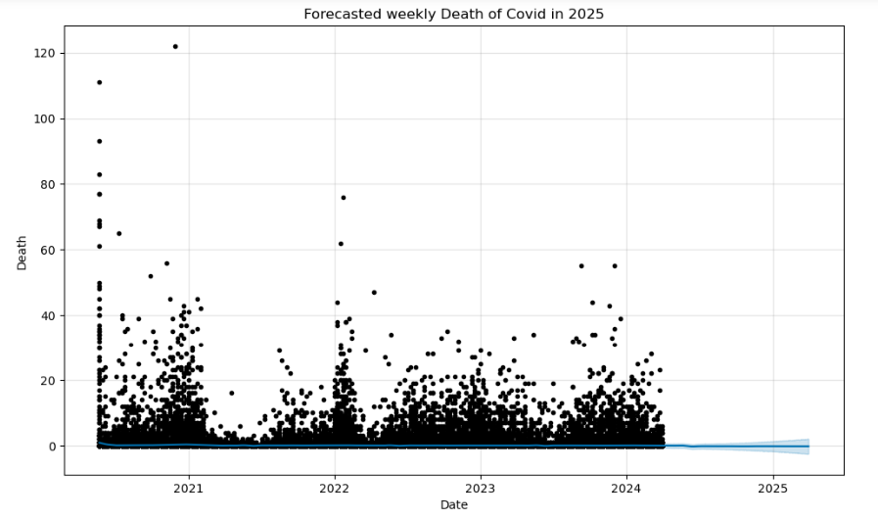
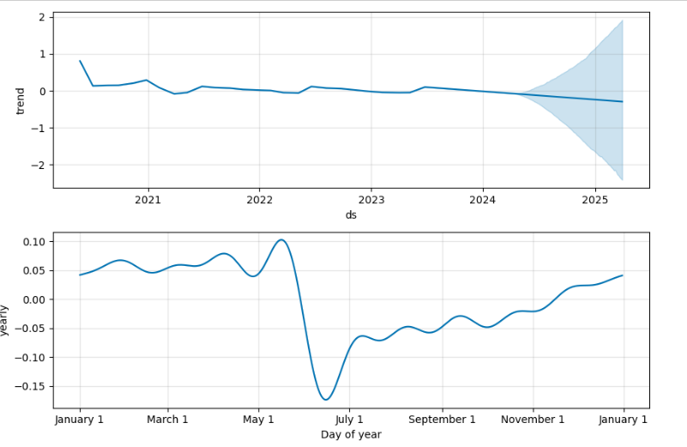
Methodology. Seasonal decomposition
Looking at the trend values, it seems that the trend starts with a positive value, indicating an increasing trend in COVID-19 deaths. However, around mid-2022, the trend starts to decrease steadily, indicating a potential decline in COVID-19 deaths. This downward trend continues until the end of the data period. In forecast we can see that covid death cases continued decline.
Mean Absolute Error: 0.34
Mean Squared Error: 0.14
Root Mean Squared Error: 0.38

Slide 11
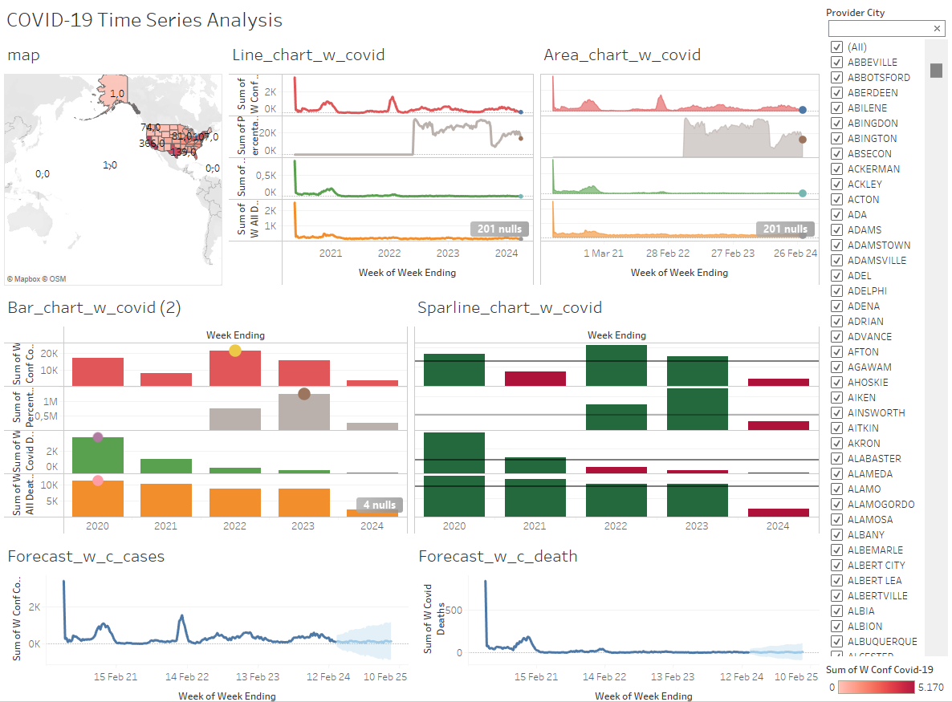
Visualizing Results with Tableau

Slide 12

Conclusion
The analysis highlights the importance of understanding seasonal patterns and trends in COVID-19 data.
Both seasonal decomposition and Prophet analysis provide valuable insights into the trajectory of COVID-19 cases and deaths.
The forecasted decline in weekly COVID-19 deaths and COVID-19 cases offers hope for the effectiveness of control measures and vaccination efforts.

Slide 13

Thank you
Orlova Tetiana

